Slide 1








Trading Bot on BTC
By Mohsine Zireg, Wassim Belhaj, Clément Boulay, Matthieu Briet, Tanguy Colleville
Notes:
Travail commandé par le MMSAt bref présentation du labo et énoncé du titre du projet
Pierre

Slide 2


Summary
Exploratory analysis and feature engineering
Work an classical modelling
Model with deep learning : recurrent neural network
Conclusion
Notes:
Enjeu de génie civil sur les sites à risques Tanguy

Slide 3

Data science project :
Process
Modeling
4
Preprocessing
3
EDA
2
1
a measurable goal
RMSE < 2855 $
Notes:
Ambition + Démarche

Slide 4
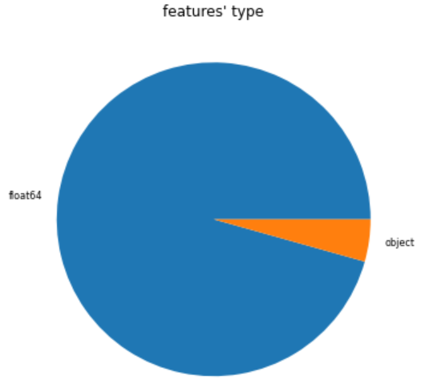
1) Exploratory Data Analysis : Shape
1 dataframe [841.1 Kb]
23 columns corresponding to different features
3544 rows corresponding to different days
Target : "market-price”
NaN ? Almost not
Which type ?

Slide 5
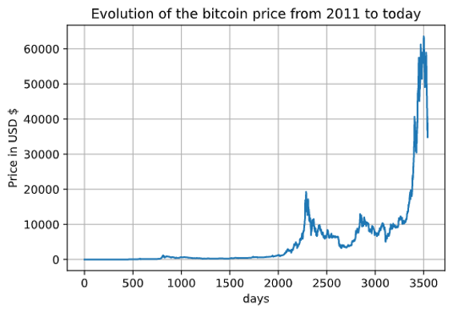
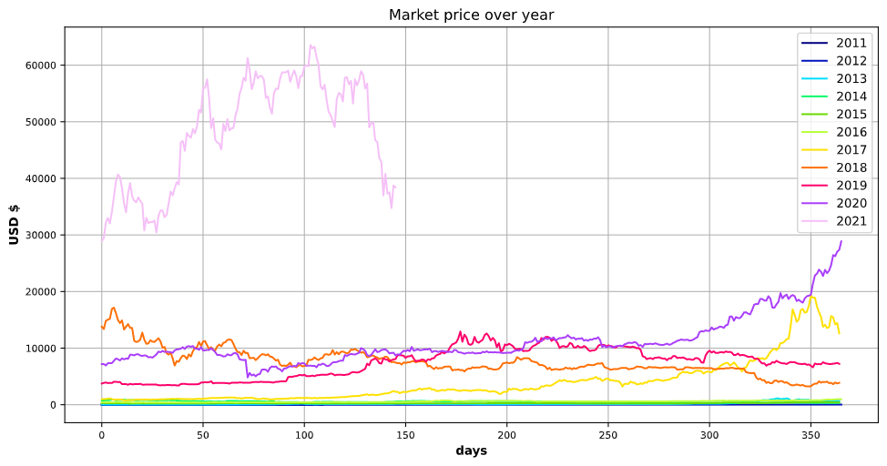
1) Exploratory Data Analysis : Content
A) Target Vizualisation
2 differents behaviours

Slide 6
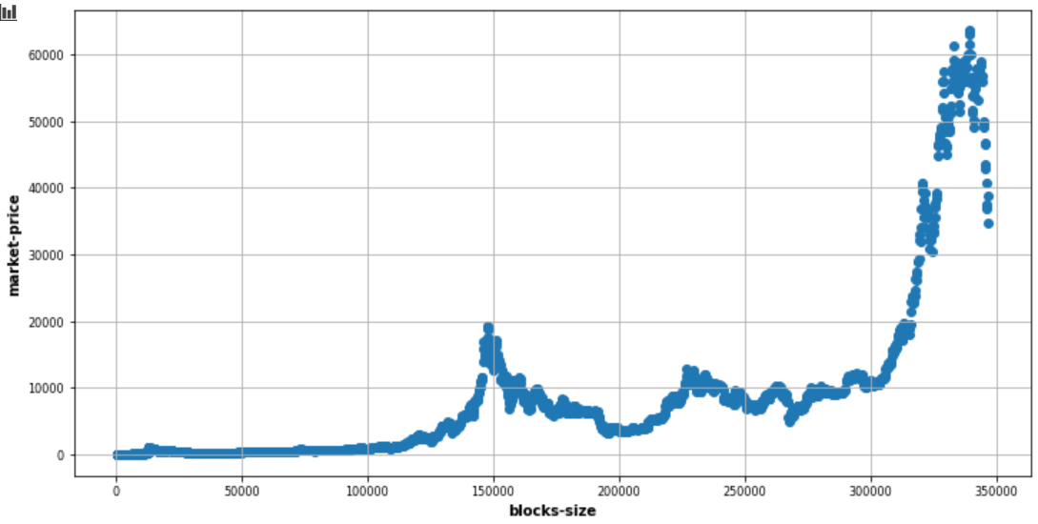
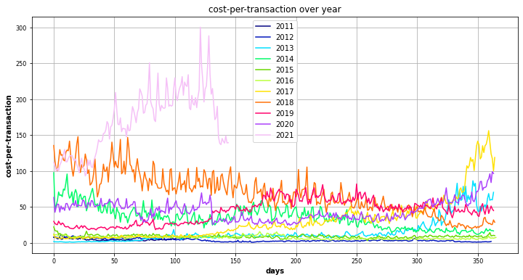
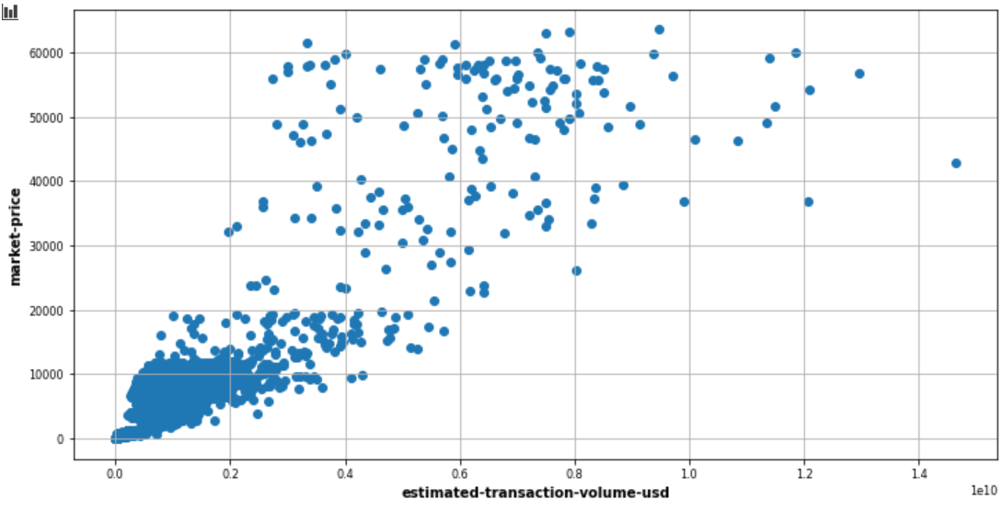
1) Exploratory Data Analysis : Content
C) Target & features distribution ?
B) Meaning of variables ? Array of information
D) Seasonality ?
E) Outliers ? Not really

Slide 7
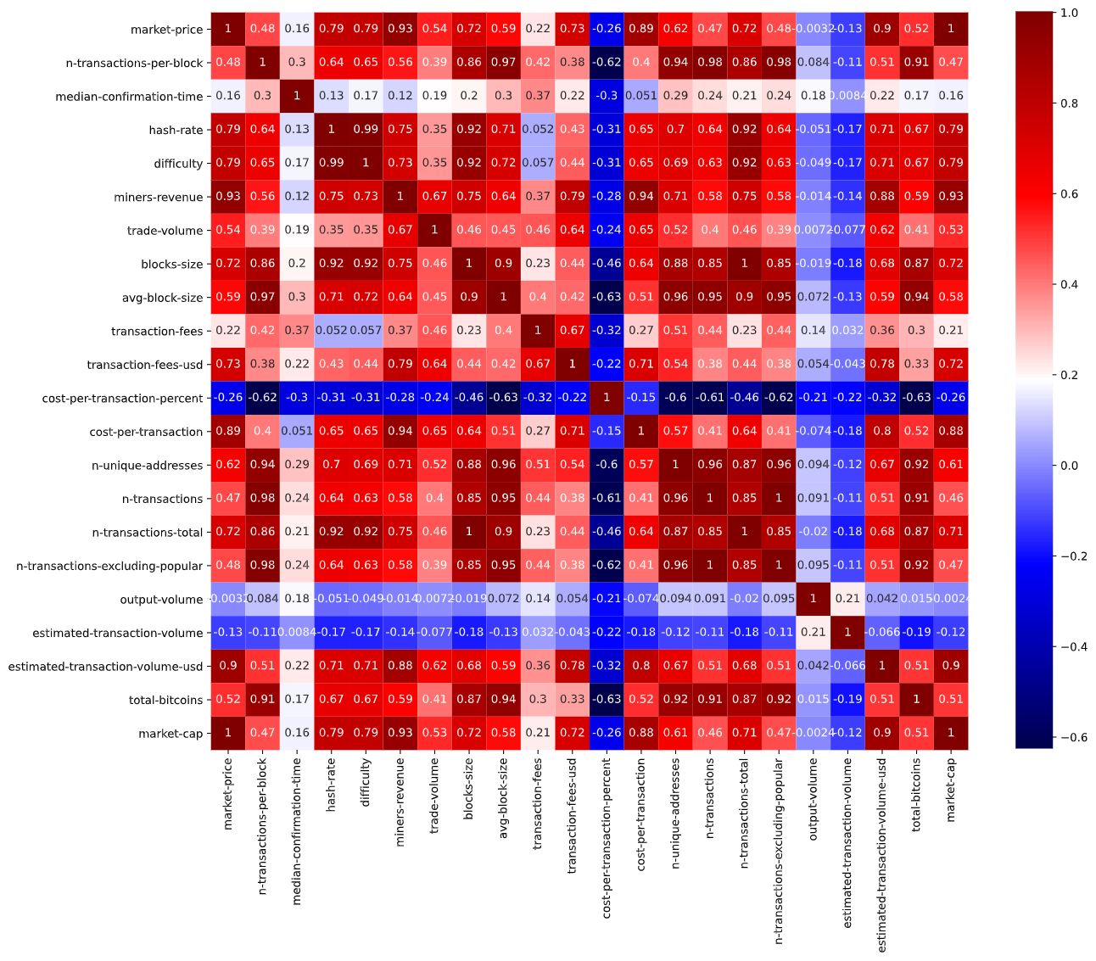
1) Exploratory Data Analysis : Content
F) Correlation ?
Are all this features relevant to forecast the price?

Slide 8

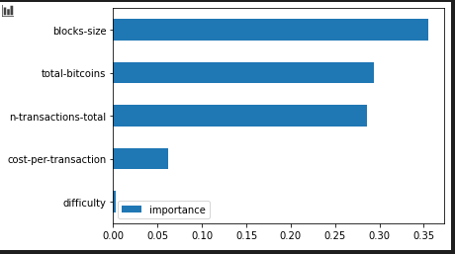
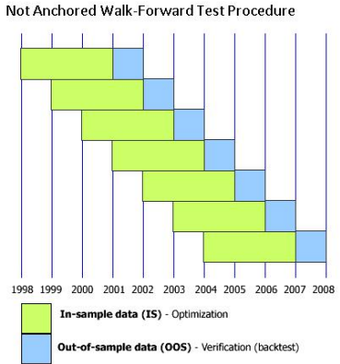
2) Preprocessing
Data from day 2000 : (12/03/2017)
Creating features from "Date" "Week day" ; "Month" ...
Analysis of the distribution of the features (symmetry)
Normalization and standardization of the features
Searching for relevant features (correlation and importance with random forest regression, LASSO)
Cross validation temporality respect
Processing by batch for RNN

Slide 9

3) Classical Modelling
Model | Best Fit | RMSE
ARMA | ARMA(3,0) | 2866 $
ARIMA | ARIMA(1,1,2) | 2862 $
ARIMAX | ARIMAX (1,1,2) (15 relevant features) | 2850 $
ARIMAX | ARIMAX(2,1,1) (8 relevant features) | 2737 $
- 4 %
A huge set of parameter to evaluate, maybe not the best possibility

Slide 10
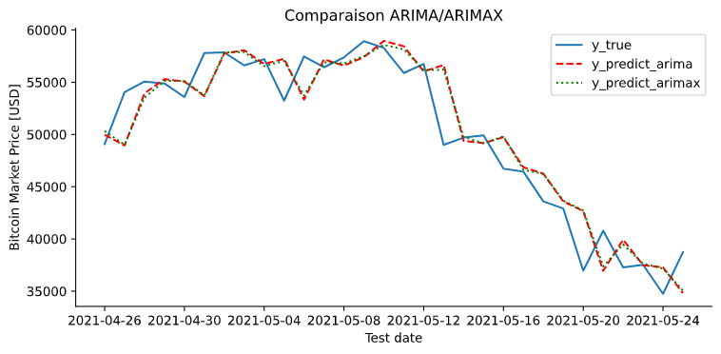
3) Classical Modelling
No real difference

Slide 11











4) Deep learning
Complexity
3 models
LSTM & Dense
ANN Dense
CNN & LSTM & Dense
Time series Cross Validation
Optimizer ? Adam ? RMSprop ?
Dropout ?
Batch size ?
Numbers of neurons per layer ?
Weights initialization ? Glorot ? He ?
BatchNorm ?
RandomSearchCV
Notes:
Parelr de la cross val du calcul du score
Call back pour l’overfitting
Expliquer tous les mots dans le nuage

Slide 12
4) Deep learning
Random Search
Batch Size
Training
Predicting
Saving
Notes:
Parelr de la cross val du calcul du score
Call back pour l’overfitting
Expliquer tous les mots dans le nuage

Slide 13
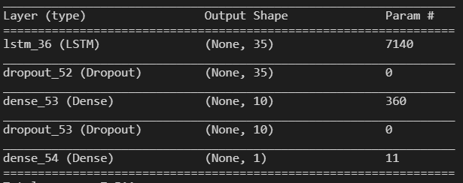
4) Deep learning :
LSTM
Dimension Analysis ? Return sequence only for STACKED
Dense 1 at the end
BackPropGrad → smooth dim variation
RandomSearchCV → Units LSTM, Neurons Dense, LN, Optimizer
Notes:
Nico

Slide 14
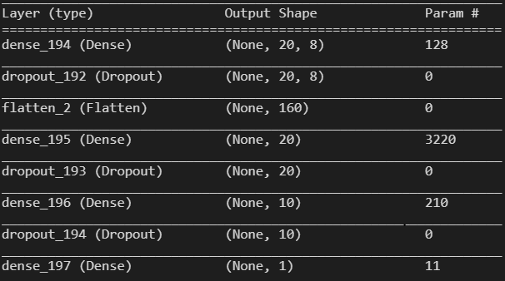
4) Deep learning :
ANN
Dimension Analysis ? Flatten get back in 1D
BackPropGrad --> smooth dim variation
RandomSearchCV → 3 numbers of neurons per layer, LN, Optimizer

Slide 15
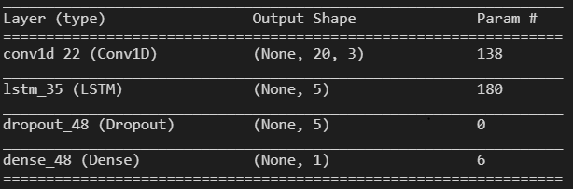
4) Deep learning :
CNN & RNN
BackPropGrad --> smooth dim variation
RandomSearchCV →, LN, Optimizer, Filter, Kernel, LSTM units
Notes:
Nico

Slide 16
4) Deep learning : Results
Loss : RMSE
Metrics : RMSE
Dropout : 0,3
Early stopping : on val_loss patience 5
Learning curve : CV but high error
Model | Optimizer | Initializer | Batch_size | BatchNorm | Learning R
LSTM | RMSprop | Glorot Normal | 128 | No | 0.02
ANN | Adam | Glorot Uniform | 64 | No | 0.001
CNN+LSTM | RMSprop | Random Normal | 64 | No | 0.15
Notes:
Btach size peut être lim par la ram

Slide 17
5) Comparison between models
Model | Execution Time | Number of parameters | RMSE
ARIMAX(2,1,1) | 20s | 8 | 2737 $
LSTM | 17,82s | 7511 | 8854 $
ANN | 4,18s | 3569 | 10616 $
CNN+LSTM | 197,13s | 324 | 42172 $
Notes:
Nico

Slide 18



Conclusion
Done
The future ?
Goals
Features engineering improvement
Programmation GPU
Hyperparameters Fine Tuning
Architecture improvement
ARIMAX with different sets of features
EDA
Preprocessing
ARIMA
ARIMAX on different set
RNN / ANN
Reduce RMSE with ARIMAX( best set)
Same with Deep learning solution
Notes:
Alexandre

